Slide 1
Energy Efficiency in a Manufacturing Enterprise
Sanjeev Khanna, PhD Director, Midwest Industrial Training & Assessment Center Professor, Mechanical & Aerospace Engineering University of Missouri 573 884 9109, khannas@Missouri.edu
College of Engineering

Slide 2
ITAC - Introduction
Goals: The ITAC provides energy efficiency, productivity, sustainability and economically competitive recommendations to small and medium (SME) manufacturing enterprises in the central Midwest region (Missouri, Kansas, South-East Illinois, eastern Iowa) .
Impact: save 5-7% in energy consumption to 100 SMEs, with additional savings to non-participating SMEs while producing job ready students for the next decade in advanced manufacturing-energy related fields.
Additional Goal: Provide energy efficiency recommendations to medium (~100,000 ft²) commercial buildings in Midwest.

Slide 3
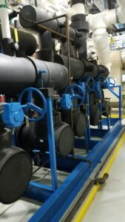
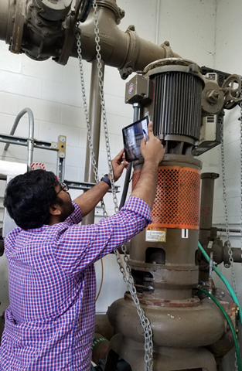
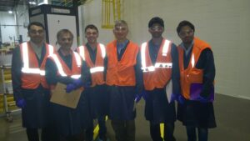
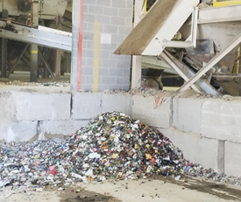
Midwest Industrial Training & Assessment Center
Provides No-Cost Energy Assessment to
Manufacturers in Central Midwest
Student Training
Reduce Energy
Use
Teamwork
Waste Reduction
Outreach
https://MidwestIAC.Missouri.edu

Slide 4
IAC Locations in US-Universities
https://IAC.University

Slide 5
Historical Results Nationally
Over 21,500 assessments
Over 160,285 recommendations
Over $140,610 average annual savings (recommended)
SRI survey:
IAC graduates accumulate significantly more energy efficiency skills, with a higher market value, compared to two control groups
Source (October 2021): https://iac.university

Slide 6
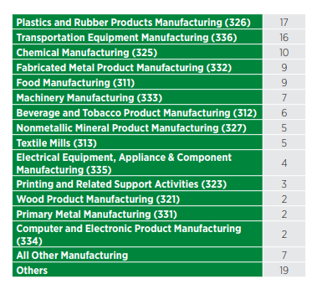
Quarterly National Snapshot (Recent Quarter)

Slide 7
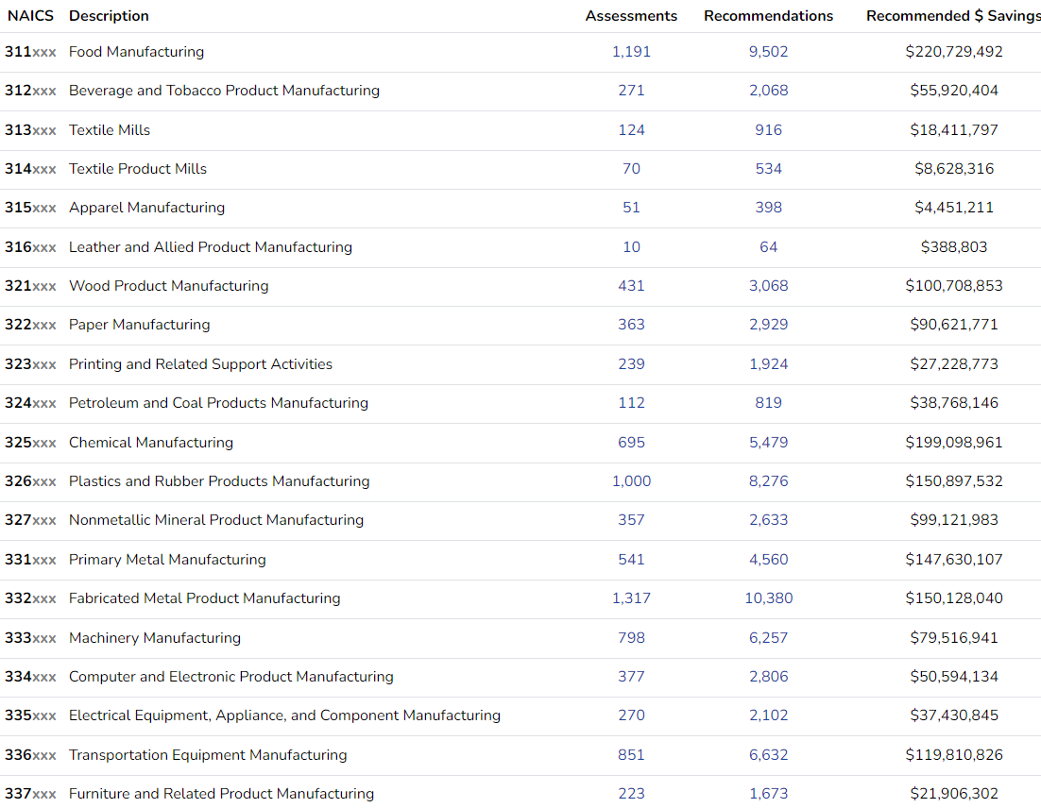
National Snapshot (to date)

Slide 8
Eligibility to Request a No-Cost Assessment
Must be a US Manufacturer
Standard Industrial Classification (SIC) 2000-3999
Less than 500 employees
Gross annual sales below $250 million
Annual energy bills:
Greater than $100,000
Less than $3,500,000
Within 150-200 miles of an IAC
[Exceptions to the criteria are possible with DOE permission]
The Energy Assessment is Free ☺

Slide 9
Assessment Process
Pre-assessment questionnaire
provide 12-months of utility bills
One (most common) or two-day on-site visit
Engineering measurements using data loggers and equipment
Requires on-site electrician/maintenance personnel
Process analysis and recommendations
Confidential report
Details the analysis, recommendations, energy and cost savings, and corresponding payback period
Follow-up within about 9-10 months
Verify implementation status

Slide 10
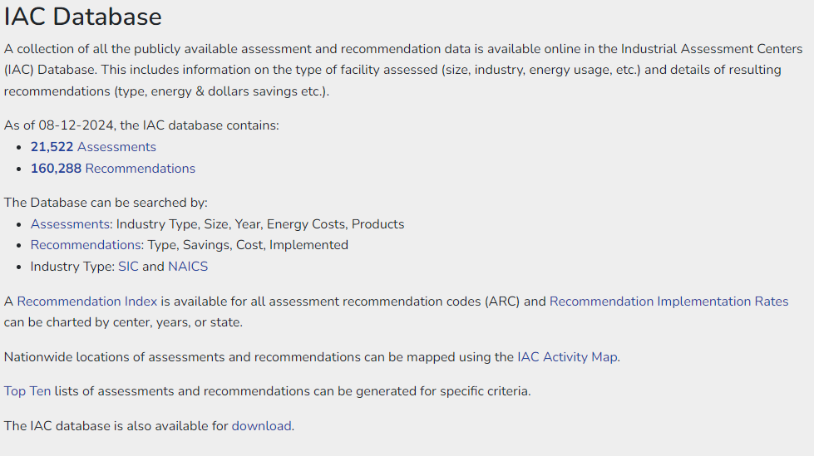
https://iac.university/download

Slide 11
Implementation Grant Funding under IRA
$300,000 per recommendation
https://www.energywerx.org/opportunities/iacimplementationgrants

Slide 12
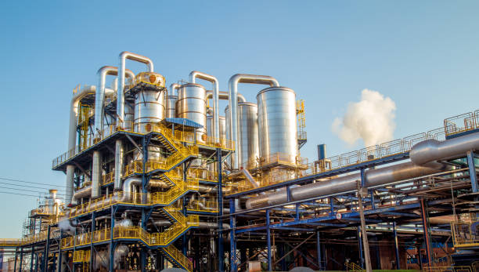
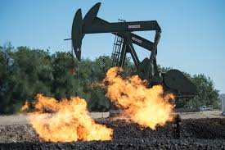
Impact of Midwest Industrial Assessment Center on Central Midwest
In the period 2007-2023:
335 industries assessed
165 Million kWh /yr electric usage savings
281 MW electric demand savings
450 Billion BTU /yr fuel savings
Cumulative CO₂ savings: 0.79 Million tons/yr
Cumulative dollar savings: $113 Million (over $330,000/industry)

Slide 13
Current and Future Emphasis of IAC
Reduce Energy consumption
Reduce electric demand
Reduce waste, with emphasis on water
Workforce development for Energy Sector
Promote decarbonization of the manufacturing sector
Promote the use of renewable energy, especially solar energy, in manufacturing enterprises
Promote energy storage solutions and resiliency in the manufacturing sector
Provide energy assessments to industry in disadvantaged communities and counties

Slide 14
Need an Energy Assessment of your Manufacturing Plant or Commercial Building
Please contact:
Dr. Sanjeev Khanna
email: khannas@missouri.edu
Phone: 573 884 9109
Or visit the Website
https://MidwestIAC.Missouri.edu

Slide 15
MU Energy Assessment Example: Aluminum sheet and foils
Plant square footage: 181,000 ft²
Annual energy costs: $1,400,000
Identified 12 energy saving recommendations
Recommended savings:
Electric usage: 593,000 kwh
Demand: 1,500 kw-mon/yr
Natural gas: 38,000 MMBtu
Total cost savings: $475,000
CO₂ reduction: 5,600,000 lbs (2,800 tons)

Slide 16
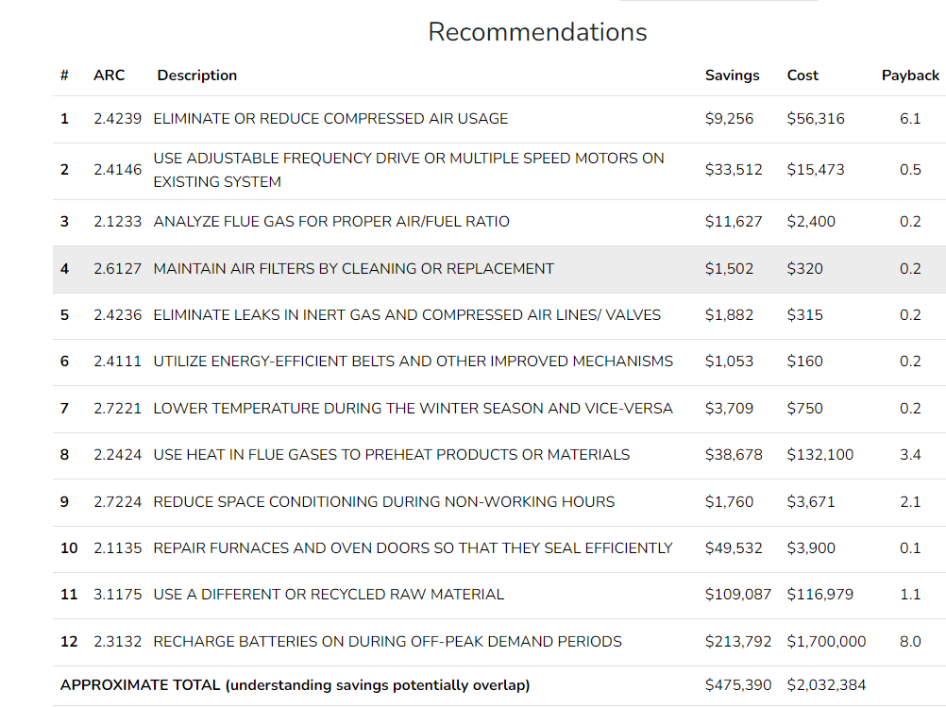
Energy Saving Recommendations

Slide 17
IAC Student Intern Training
Energy efficiency in manufacturing systems
In-house training and MAE4350/7355 semester course
Workshop on ISO 50001 Energy Management Standard
Workshop on Cybersecurity
Workshop on Water and Wastewater
Workshop on power plant systems and building energy control
In future, add a workshop on Smart Manufacturing
Student Interns also get paid ☺

Slide 18
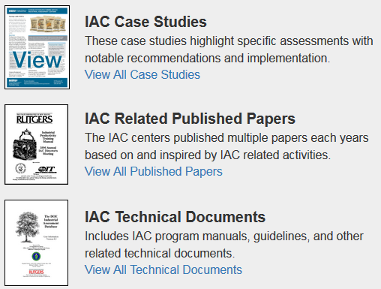
IAC Resources
https://iac.university

Slide 19
Resilience in Manufacturing
Decarbonization
Renewable energy sources
Energy storage that can assist in following the demand in a cost-effective manner
Suitable policies, regulations, incentives, market forces needed
Future technology in renewables and carbon capture is still a moving target

Slide 20
Screening Tool for Industrial Resilience (STIR) https://STIR.pnnl.gov/
STIR is a risk-informed high-level resilience planning web tool. It provides a short list of potential solutions to mitigate risk and improve resilience based on key risk drivers identified in the STIR risk assessment. These findings are meant to complement the traditional findings of the IAC energy assessment process.
The STIR focuses on characterizing risk associated with three main risk sources: energy and water outages, disruptions due to failure of a critical asset, and supply chain disruptions.

Slide 21
The outputs of this analysis can be useful to a manufacturer that is trying to mitigate a loss of profit due to time loss caused by an outage or equipment failure.
The STIR provides tailored risk analysis and visuals that can help the business determine which areas may be resilience weaknesses.
If funding for resilience solutions is limited, the STIR can help demonstrate where the funds will be best spent to mitigate profit loss during a resilience event. Additionally, the STIR provides solution suggestions as a starting place and links to resources to learn more.

Slide 22
Resilience for Manufacturers
Resilience refers broadly to the ability to anticipate, prepare for, and adapt to changing conditions and to withstand, respond to, and recover rapidly from disruptions through adaptable and holistic planning and technical solutions.
Key elements and outcomes of resilience planning include:
Optimized operations to reduce energy and water use, as well as peak demand, that enable the site to meet energy and water requirements
Trained personnel and capabilities to rapidly recover from disruptions due to planned and unplanned events
Actionable strategies for diverse solutions that address resource and infrastructure needs to minimize the consequence of interruptions to key processes during normal and disrupted operations.

Slide 23
STIR Tool Overview
The STIR is broken out into four key sections:
1. Site-Wide Information
2. Asset Information
3. Disruptions
4. Outputs
The first three sections will require user input, from data collected during the site visit. The Outputs section will provide a short list of potential resilience solutions based on key risk drivers identified in the previous sections.

Slide 24
STIR Inputs
Site-Wide Information
Site details
Key processes
Process operation
Supply chain
Asset Information
Client assets
Asset condition
Redundant systems
Disruptions
Hazards
Critical asset failure
Supply chain disruptions

Slide 25
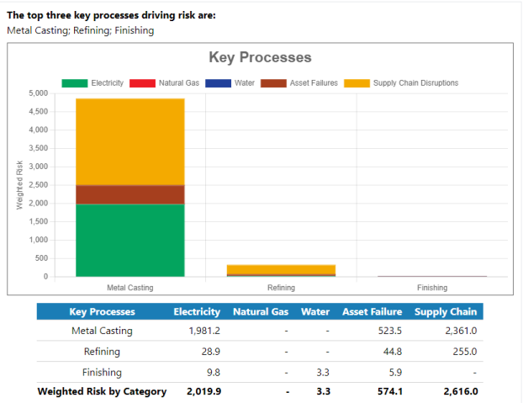
STIR Output

Slide 26
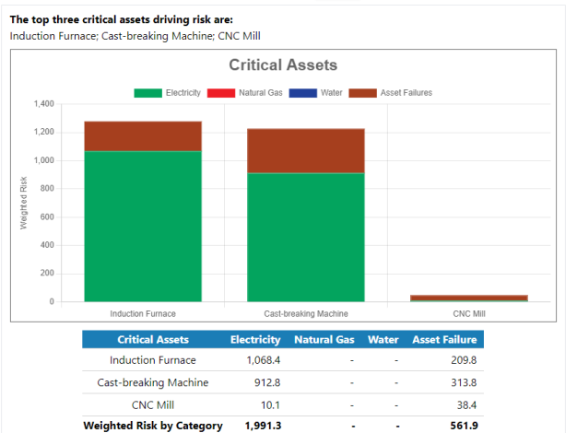
STIR Output

Slide 27
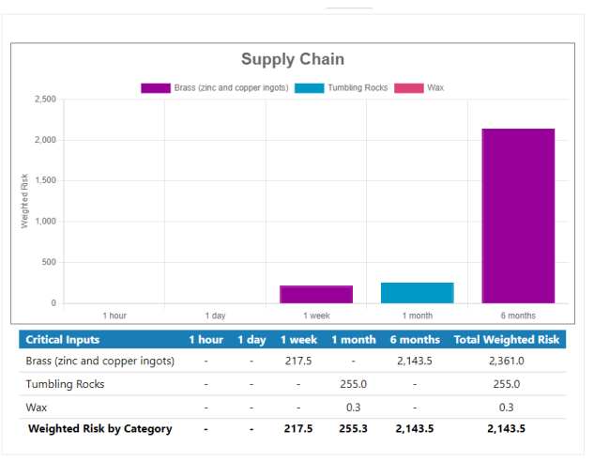
STIR Output

Slide 28
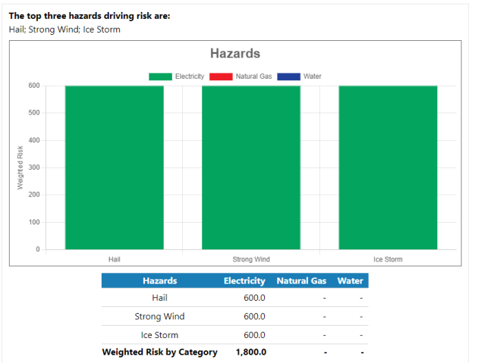
STIR Output

Slide 29
Resilience Solutions: Hazard Mitigation
Implement wind hardening
Implement winter weather hardening
Coordinate with local &/or regional emergency management
Develop pre-event plant checklists

Slide 30
Resilience Solutions: Site-Wide
Explore grid flexibility opportunities
Identify opportunities for transmission redundancy
Develop distributed resources
Develop emergency/continuity plans

Slide 31
Resilience Solutions: Critical assets
Replace assets nearing end-of-life
Store replacement parts for critical assets
Support critical assets with a redundant electricity system
Implement energy efficiency measures for runtime extension
Store critical replacement parts

Slide 32
Need an Energy Assessment of your Manufacturing Plant or Commercial Building
Please contact:
Dr. Sanjeev Khanna
email: khannas@missouri.edu
Phone: 573 884 9109
Or visit the Website
https://MidwestIAC.Missouri.edu

Slide 33
THANK YOU !!

