Slide 1
Electrical Board Missouri Illinois
Leading the Way to a Sustainable Energy Future
August 23, 2024

Slide 2
Low Carbon Technologies
Discussion Points
Net Zero in Power Generation
Low Carbon in the Industrial Sector
What Might Net Zero 2050 look like?
2

Slide 3
Low Carbon Technologies
Net Zero for Ameren
 | Technology | Years to Commissioning | 2023 LCOE, $/MWh | 2035 LCOE, $/MWh | Net Plant Capacity, MW | Capacity Factor, %
 | Lithium Ion | 2-3 | 200 | 150 | 20-100 | 17%
 | Solar PV | 2-4 | 55 | 38 | 50-150 | 20-35
 | Reciprocating Engine | 2-4 | 240 | 230 | 75-220 | 10
 | NG Combustion Turbine (CT) | 2-5 | 136 | 130 | 230-400 | 10
 | H2-Fired Aeroderivative CT | 2-5 | 425 | 375 | 40 | 10
 | Onshore Wind | 3-6 | 53 | 43 | 50-250 | 30-50
 | NGCC | 3-6 | 37 | 35 | 350-1,080 | 85
 | NGCC + 90% CCS | 4-9 | 60 | 55 | 930-950 | 85
 | Offshore Wind | 8-12 | 117 | 73 | 900 | 20-35
 | Nuclear | 10-20 | 137 | 134 | 1,120-2,300 | 90
 | Small Modular Reactor | 8-10 | 127 | 108 | 480-875 | 90
 | Pumped Storage Hydro | 8-22 | 165 | - | 100-1,000 | 25-30
Source: https://www.epri.com/research/products/000000003002029428
3

Slide 4
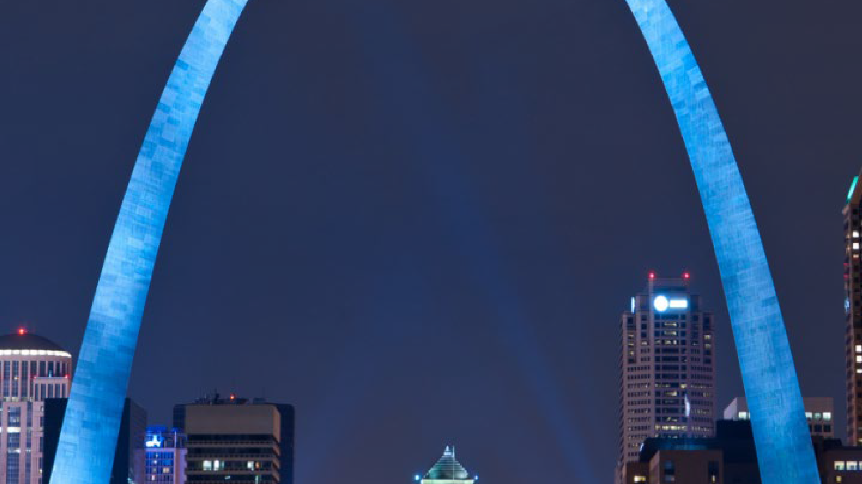
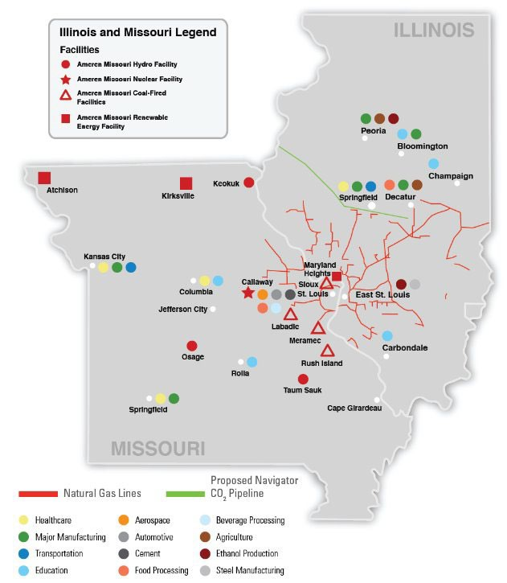
Greater St Louis and Illinois Regional Clean Hydrogen Hub Industrial Cluster
Ameren
Economic Development Session
St. Louis, Missouri

Slide 5
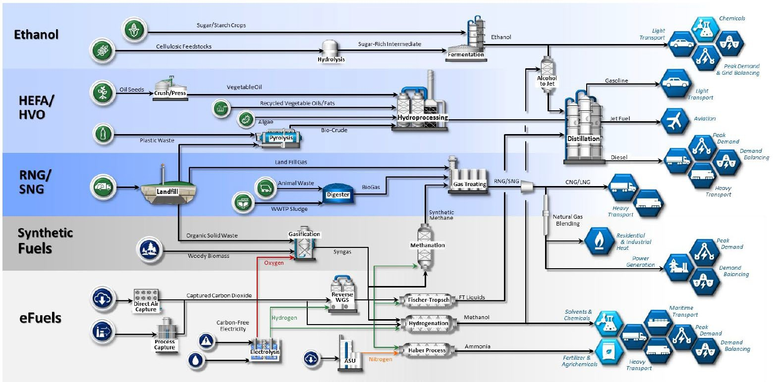
Low Carbon, Renewable Fuels
Decarbonizing other industries
5

Slide 6
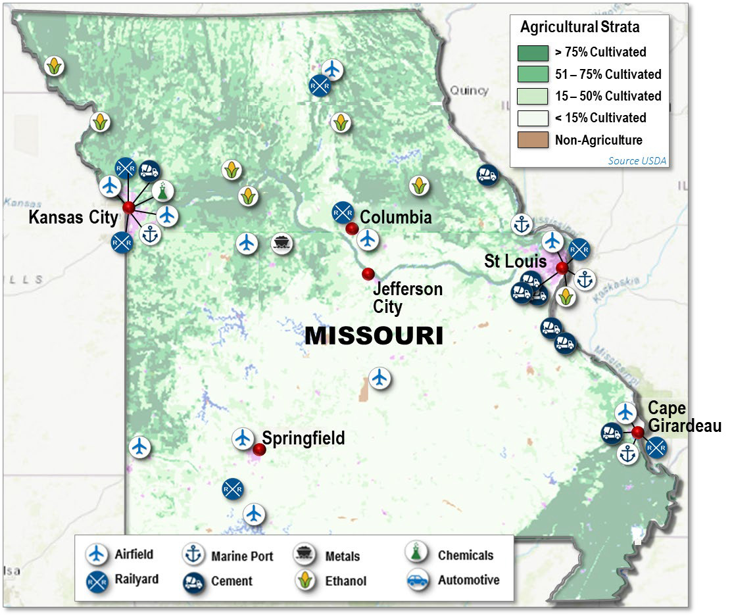
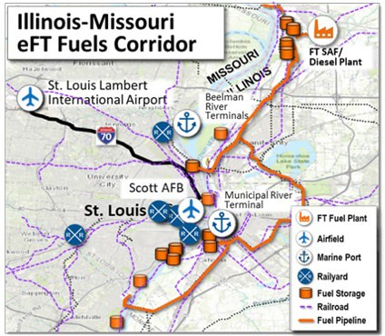
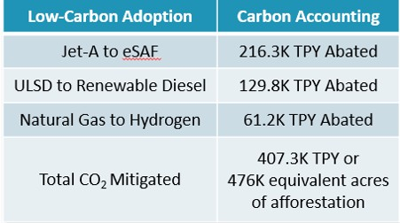
What could a Net Zero 2050 look like?
The Missouri Industrial Ecosystem

Slide 7
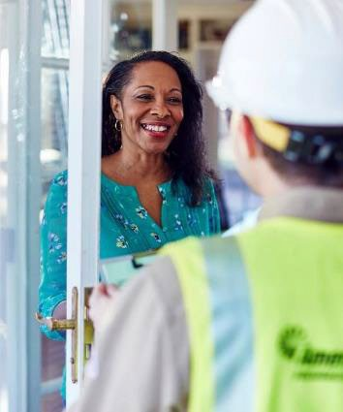
Questions
7

