Slide 1
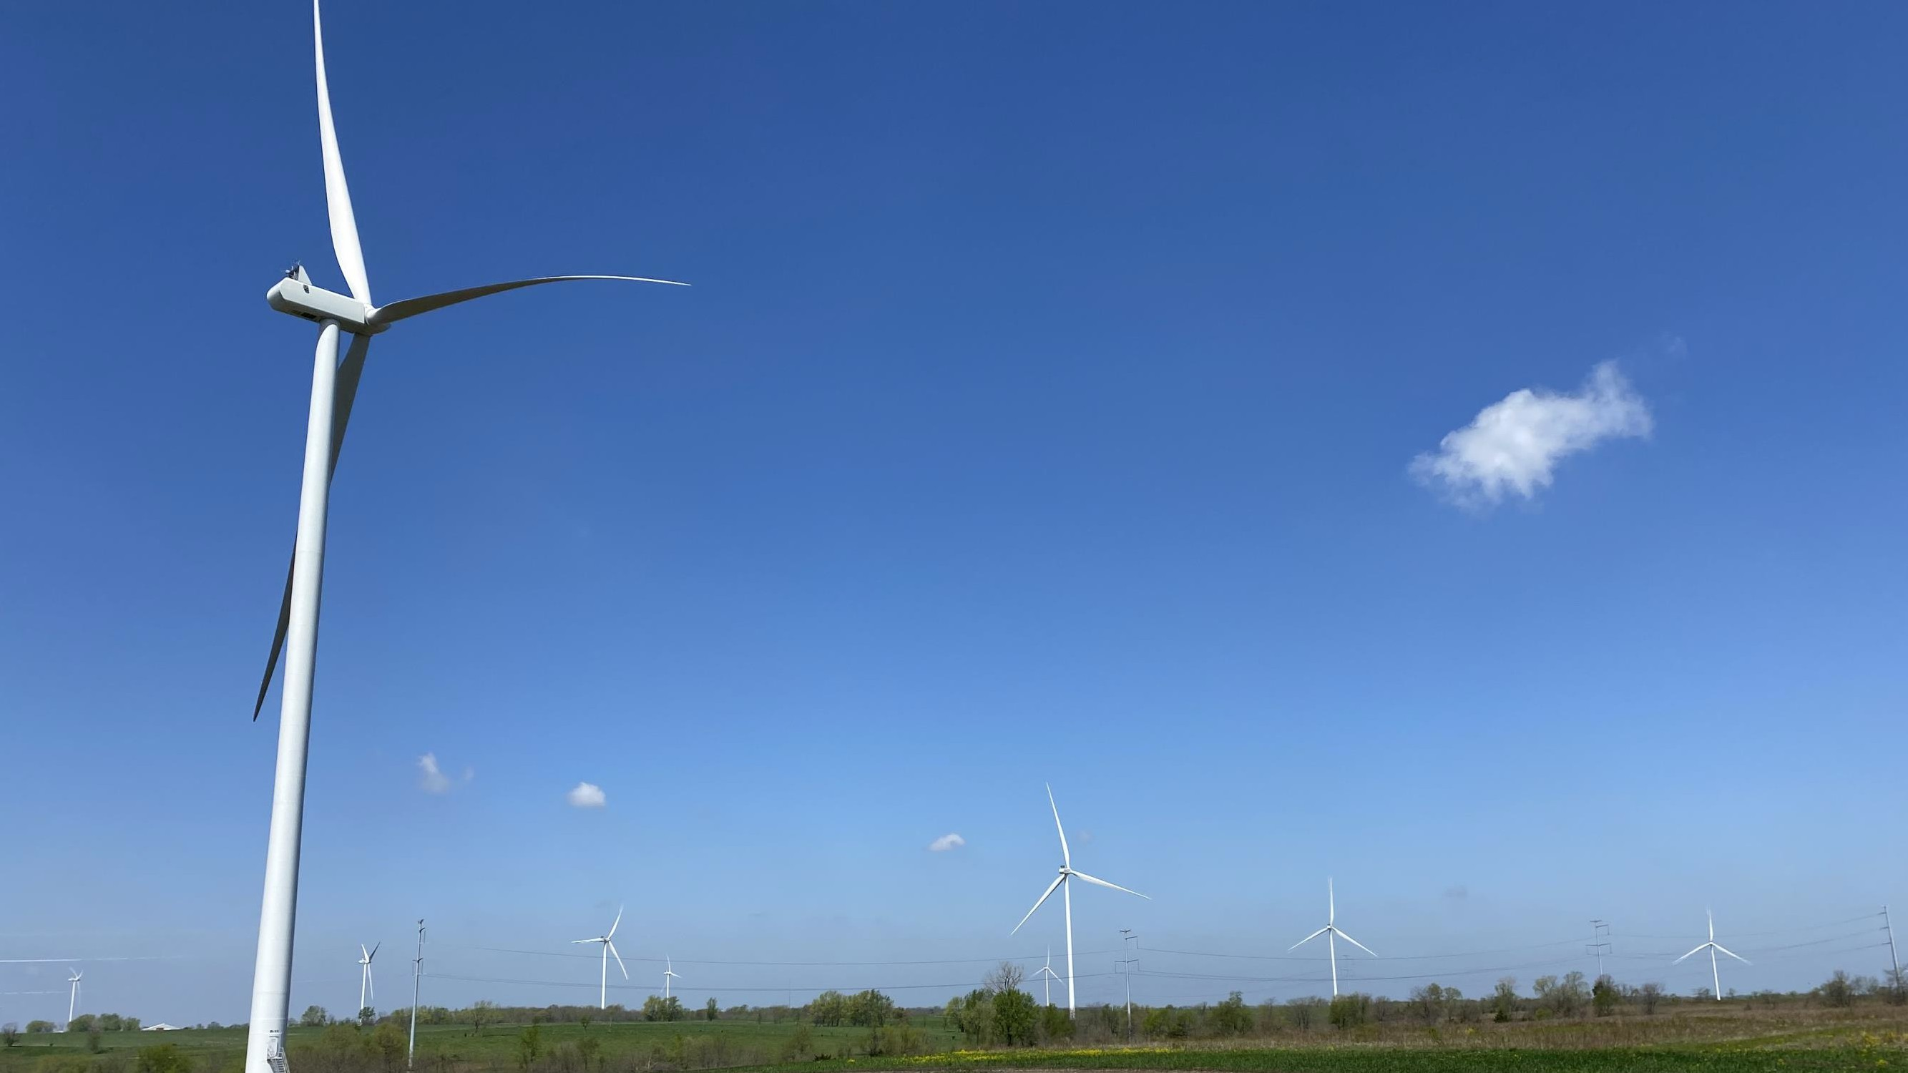
Clean Energy Symposium
Ameren Sustainability Journey
Kisha Hines - Director Corporate Sustainability
1

Slide 2
How We Integrate Sustainability

Slide 3
How We Think About Sustainability
ENVIRONMENTAL STEWARDSHIP
Operating to reduce emissions and waste and preserving natural resources while providing safe, reliable, and affordable electric
and natural gas services
SOCIAL IMPACT
Placing people at the center of everything we do by supporting customers, empowering co- workers and enabling more sustainable communities
Vision:
Leading the Way to a Sustainable Energy Future
Mission: To Power the Quality of Life
GOVERNANCE
Executing policies and principles that integrate sustainability matters into our risk management and strategic planning frameworks, as well as providing strong oversight
SUSTAINABLE GROWTH
Delivering superior and sustainable long-term value to our customers, the communities we serve, our shareholders and the environment

Slide 4
Our Sustainability Value Proposition
ENVIRONMENTAL STEWARDSHIP | SOCIAL IMPACT
Responsibly transitioning to a cleaner and more diverse portfolio Target carbon reductions from 2005 levels: 60% by 2030; 85% by 2040; net zero by 2045¹ Target additional renewable resources: 2,800 MW by 2030 and total of 4,700 MWs by 2036 Systematic coal-fired energy center retirements; extend life of carbon-free nuclear energy center Preferred plan consistent with objective of the Paris Agreement to limit global temperature rise to 1.5 degrees Celsius Significant transmission investment supporting cleaner energy No cast or wrought iron pipes in natural gas system ¹ Ameren’s goals include both Scope 1 and 2 emissions including other greenhouse gas emissions of methane, nitrous oxide and sulfur hexafluoride. | Delivered value to customers in 2023 while focused on safety Ameren-supplied residential customer rates, on average, below midwest average Ameren achieved top quartile reliability performance¹ Ameren achieved its lowest recordable incident rate Socially responsible and economically impactful Diverse business spend in MO and IL ~26% of 2023 sourceable spend ~$215M to support eligible customers and charities in 2023 Dedicated to building an inclusive and engaged culture Inducted into Fair360 Hall of Fame in 2023; became 1 of 12 companies and only utility in Hall of Fame; previously in top 5 on utilities list since 2009 Recognized as a Military Friendly Employer for 14 consecutive years and Disability Equality Index Best Place to Work for 10 consecutive years ¹ As measured by Ameren Missouri and Ameren Illinois outage frequency indexes (SAIFI).
GOVERNANCE | SUSTAINABLE GROWTH
Diverse BOD focused on strong oversight 69% women or racially/ethnically diverse; average tenure of ~8.5 years BOD and committee oversight aligned with sustainability matters Strong organizational focus: Chief Sustainability, Diversity, and Philanthropy Officer, Chief Ethics and Compliance Officer and Chief Renewable Development Officer Executive compensation supports sustainable, LT performance 10% long-term incentive for clean energy transition 5% short-term incentive for local small or local diverse supplier spend and diversity of workforce opportunity Among top ranked companies in CPA-Zicklin Index for Corp. Political Disclosure and Accountability | Expect 6% to 8% EPS CAGR 2024-2028^{1,2} Expect 8.2% rate base CAGR 2023-2028¹ Four regulatory jurisdictions for investment Strong long-term infrastructure investment pipeline of $55+ billion 2024-2033¹ Expect future dividend growth to be in line with long-term EPS growth expectations ¹ Effective as of Feb. 23, 2024 Earnings Conference Call. ² Using 2024 EPS guidance range midpoint of $4.62 as the base.

Slide 5
How We View Sustainability Pillars and Risks
Pillars | Environmental | Social Impact | Governance | Sustainable Growth
Key areas of focus | Climate Change Emissions Reductions Environmental Compliance Natural Resource Management | Community Impact Diversity, Equity & Inclusion Energy Costs for Customers Health and Safety Human Capital Sustainable Supply Chain | Board Composition and Committee Oversight Incentive Compensation Data Privacy/Cyber Security Enterprise Risk Ethics and Compliance Management Accountability Regulatory and Legislative Engagement | Infrastructure Investment Disciplined Cost Management Constructive Energy and Economic Policies Economic Development Efficient Electrification Innovation
RISKS: FINANCIAL • LEGISLATIVE • REGULATORY • SECURITY • REPUTATIONAL
Ameren’s Enterprise Risk Management program is a comprehensive framework that is designed to identify, evaluate
and manage risk across the environmental, social, governance and sustainable growth pillars

Slide 6
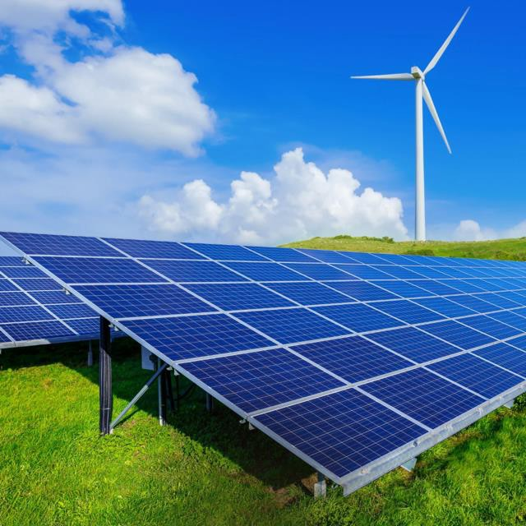
Ameren’s Clean Energy Transition
Pathway to deliver safe, reliable, and affordable energy
Infrastructure and technology Investments, & related activities
Transition from fossil fuels to sustainable, low-carbon energy sources
Just and Equitable transition
Pathway to achieve our companywide goal of Net Zero by 2045
Decarbonization and enabling of a shared integrated grid

Slide 7
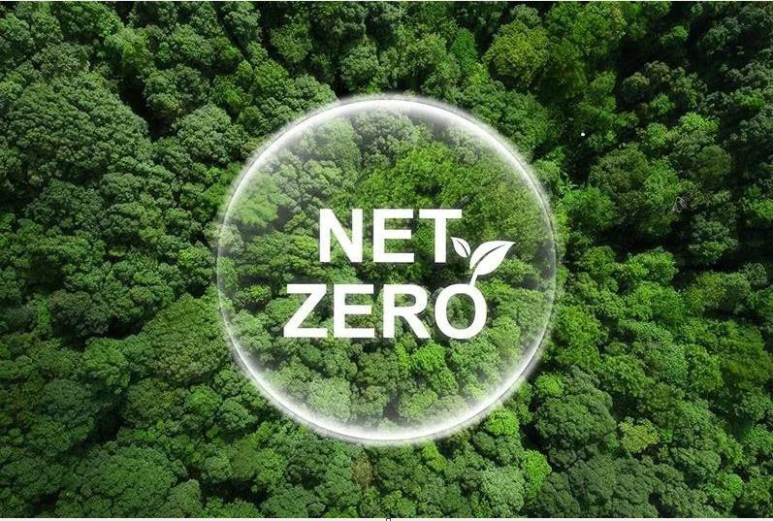
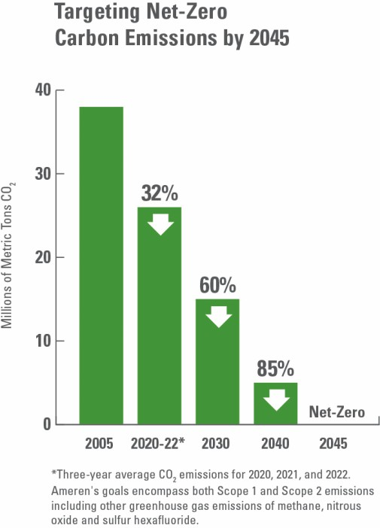
What Is Net Zero?
Net Zero refers to the balance between the amount of greenhouse gas emissions (GHG) that's produced and the amount that's removed from the atmosphere. It can be achieved through a combination of emission reduction and emission removal. Net-zero places focus on reducing carbon emissions as much as possible first and offsetting (e.g. carbon capture and sequestration or afforestation) as a last resort. Ameren’s Net Zero by 2045 target includes Scope 1 and Scope 2 greenhouse gas emissions.

Slide 8
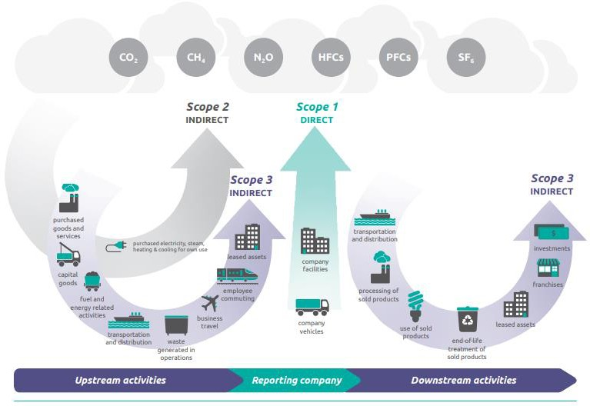
GHG Reporting: Background (Scope 1, 2, & 3)
Corporate-Value-Chain-Accounting-Reporing-Standard_041613_2.pdf (ghgprotocol.org)

Slide 9
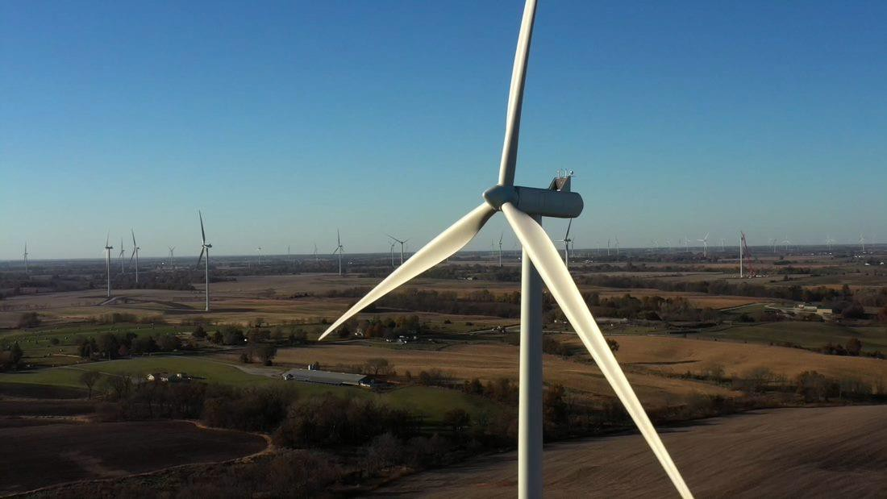
Ameren’s Greenhouse Gas Inventory
High Prairie Renewable Energy Center

Slide 10
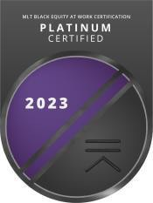
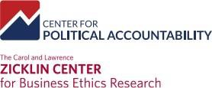
Solid Sustainability Ratings
AAA
0
A
Sept. 2023
July 2023
Feb. 2024
Climate
B
A
27.2
Medium Risk
Water
B
Range:
AAA-CCC
(AAA is best)
Range:
0-100
(Lower is better)
Range: A-F
(A is best)
CCC
100
F
Ameren Corp. 98.6
Trendsetter Oct 2023

Slide 11
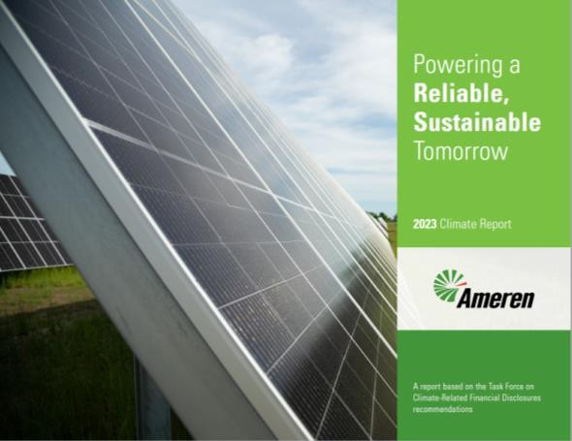
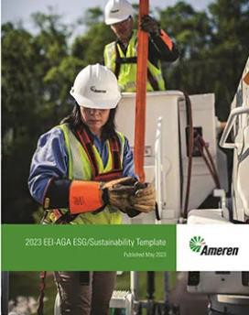
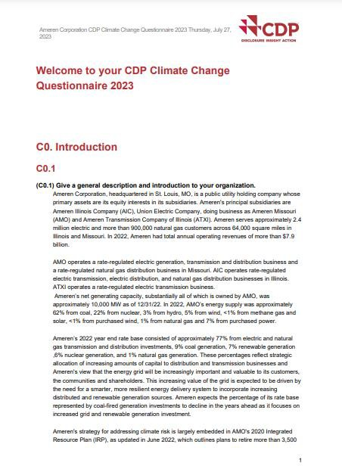
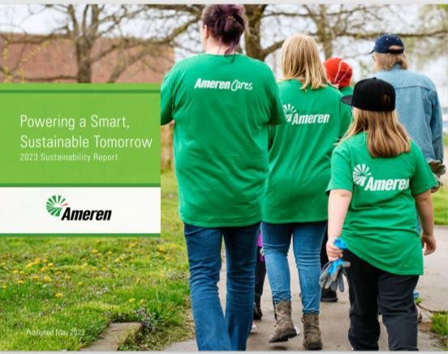
Additional Information
Current Greenhouse Reporting
Ameren Climate Risk Report, December 2023 Ameren 2023 Climate Report: Powering A Reliable Sustainable Tomorrow
CDP Climate Change with GHG Emissions Assurance/Verification Statement
Ameren 2023 CDP Climate Questionnaire
EEI/AGA Sustainability Template https://www.ameren.com/-/media/corporate- site/files/environment/reports/eei-aga-esg-sustainability- template.ashx
2023 Sustainability Report
https://www.ameren.com/-/media/corporate- site/files/environment/reports/sustainability-report.ashx

