Slide 1



Energy Audits & Thermal Batteries
Key Steps On Your Path to Net Zero
August 23, 2024
Adam Phillips, PE, CEM
Bruce Lindsay, PE, CEM

Slide 2



Jarrell Mechanical Contractors
At Jarrell, you’ll find more than Design-Build HVAC and plumbing-plus DDC controls-all under one roof. You’ll see how we fit them together to create the right solution every time. Bringing all the best people to the table with the knowledge, commitment, and passion to do whatever it takes to get the job done.
1943
Controls
Mechanical Services
Piping Fabrication Shops
Sheet Metal Fabrication Shop
Design Build HVAC and Plumbing
Value Engineering
Plan Specifications Applications
Tenant Improvement
Controls
Piping
Sheet Metal
Refrigeration
Prefab Piping Systems and Plumbing
Semi-Automatic and Welding
Pipe Cutting
Packaged Systems
Construction Methods
Slip and Cap Connections
Standard Angle Connections
Button Lock
Pittsburgh and Welded Seams
Transverse Duct Flange
TIG, MIG, Stick and Carbon Arc Welded Connections
Soldered Connections
Fab Shop Equipment
Roll Forming Machines
Power, Roto-Die and Hand Brakes Power Shear
Fully Automated 5 ft. Insulated Duct Coil Line
Computer Driven Plasma Fitting Cutter etc.
Round Spiral Machine that produces spirals such as welded elbows, reducers, end caps, etc.
Computer Driven Insulation Fitting Cutter
System Integration
Energy Optimization
Remote Monitoring and Diagnostics
Proactive Maintenance and Software Management
Utility metering and Tenant Billing
Operator Support and Training

Slide 3
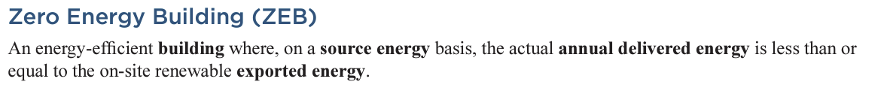

What is “Net Zero Energy”
Different than “Net Zero Emissions”
  Carbon or GHG: Scope 1, 2, and 3
How to make an existing building Net Zero Energy:
  Maximize efficiency
  Electrify
  Offset what’s left with renewables
Notes:
Energy Audits serve to identify how to maximize efficiency at an acceptable ROI.

Slide 4
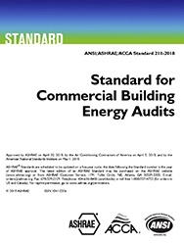
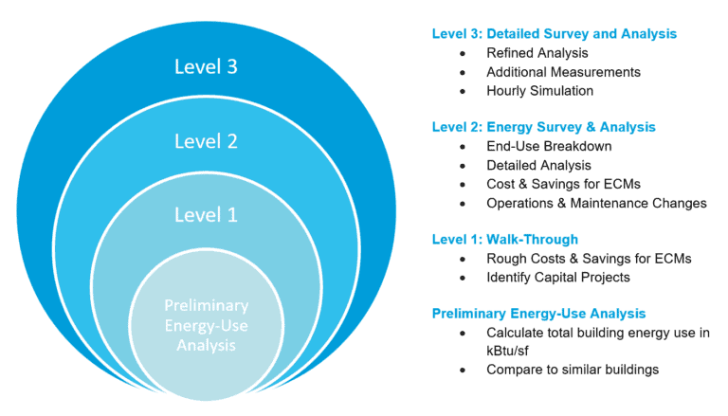
Types of Energy Audits
ASHRAE Standard 211
  Definitions: Levels 1, 2, and 3
Why Level 2? – Optimal Value
  Comprehensive energy savings identification
  Detailed budgetary financial analysis and ROI
  Actionable recommendations for improvements
Notes:
Level 1 – Looking for opportunity…but energy analysis tells you if there’s opportunity.
Level 3 – Investment Grade…you only want to invest this level of effort in what you intend to implement.

Slide 5

Benchmark First!!!
Energy Star Portfolio Manager Benefits:
Free to use
Weather normalized usage
Large database of buildings
Actively supported, maintained, and improved
Low time commitment
Notes:
Everyone should be continuously benchmarking their buildings, not just when they do an energy audit.
Allows you to prioritize and focus on the best opportunities.

Slide 6
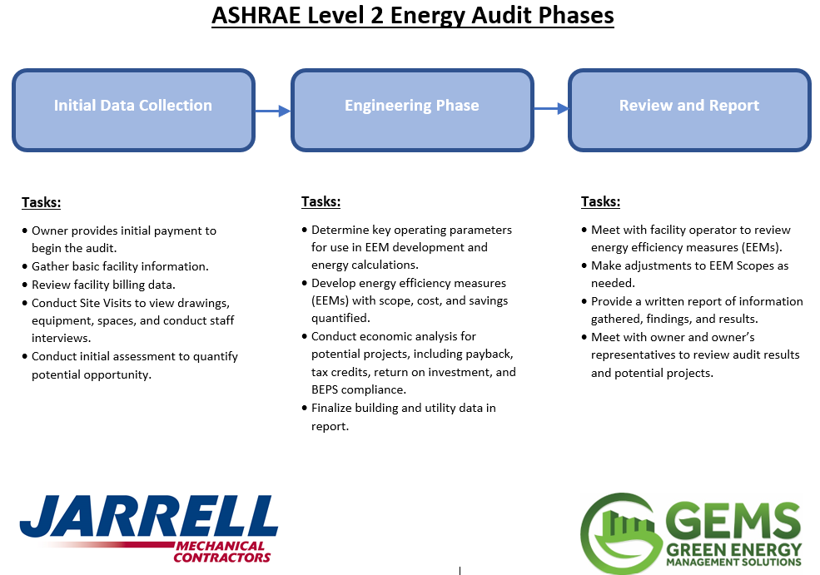
The Level 2 Energy Audit Process

Slide 7

How to Maximize Energy Audits
Determine Goals
Define Success Criteria
Collaborate
Leverage Free & Cheap Money
Leverage Savings

Slide 8

Determine Goals
Reduce Energy Costs (Obvious)
But what about…
  Reducing O&M costs (internal and external)
  Offsetting capital renewal costs (bundling)
  Improving occupant comfort (i.e. productivity)
  Assisting sustainability goals
  Marketing value
Write it Down!!!

Slide 9

Define Success Criteria
Align Criteria and Goals!!!
Financial Success (Quantifiable):
  Simple Payback
  Return on Investment (ROI)
  Net Present Value (NPV)
  Asset Market Value
  Capital Outlay
  Cashflow
Organizational Success (Hard to Quantify):
  Productivity
    Occupants
    Facilities Staff
  Other department objectives:
    Sustainability
    Marketing
Write it Down!!!

Slide 10

Collaborate
With your organization:
  Find supporters
  Find additional funding sources
With your industry:
  Peer benchmarking
  Industry best practices
  Peer successes
With your energy auditor:
  Goals
  Criteria
  Building documentation
  Issues & opportunities
  Previous studies
Not Sharing Information Reduces Audit Value!!!

Slide 11




Leverage Free & Cheap Money
Utility Incentive Programs
  First Cost Discount
State & Federal Tax Incentives
  Inflation Reduction Act, EPAct
Revolving Energy Loans & Grants
  MO Department of Natural Resources
Special Financing Vehicles
  C-PACE, Energy Savings Performance Contracting

Slide 12
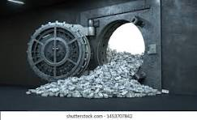
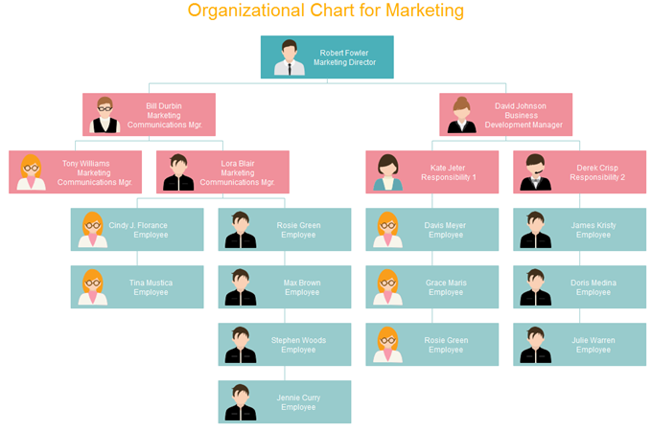
Leverage Savings
Think Strategically to Maximize Value
Bundle short and long payback projects to meet more facility needs.
Combine upgrades with other organizational objectives
  Marketing – Energy Dashboard (facility staff visibility)
  Sustainability – Shareholders

Slide 13
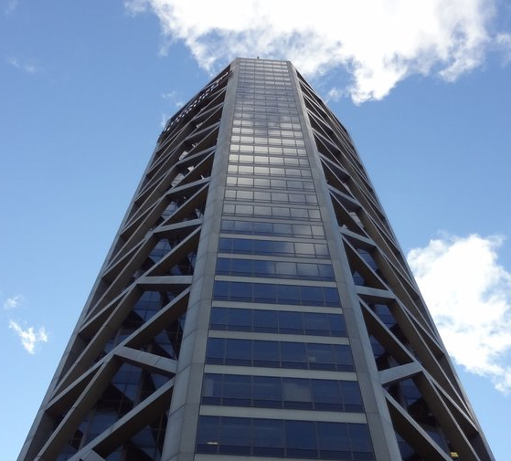
Case Study
Office Building, City of St. Louis
Audit Results
BEPS Compliance | Yes
Increased Value | $8.3 Million
Incentives | $1.3 Million
Energy Savings | $660K
Payback | 5.5 Years
ROI | 18%
10-Yr NPV | $4.3 Million
Goals
  Reduce energy costs
  Comply with STL City BEPS
  Protect asset value
Set Criteria
  Not known or not shared…negative impact
Collaborate
  Met directly with owner’s asset manager
  Preliminary analysis of several options to meet their criteria
  Repackaged savings measures 3 times to meet their goals
Leverage Funding
  Utility Incentives, C-PACE
Leverage Savings
  BAS Upgrades, Lighting Upgrades (shorter payback)
  HVAC System Conversions (longer payback)
Notes:
Segue to Bruce – Another key component in achieving net zero buildings is electrification. Bruce is going to talk about an opportunity to achieve this using thermal storage and leveraging new tax incentives.

Slide 14
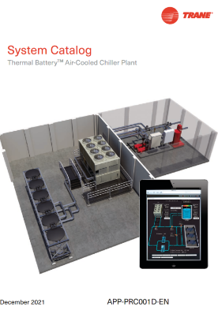

Ice Storage, Tax Credits, and Decarbonizing in Cold Cities
Bruce B. Lindsay, PE, CEM
Trane Technologies
Thermal Storage Systems

Slide 15
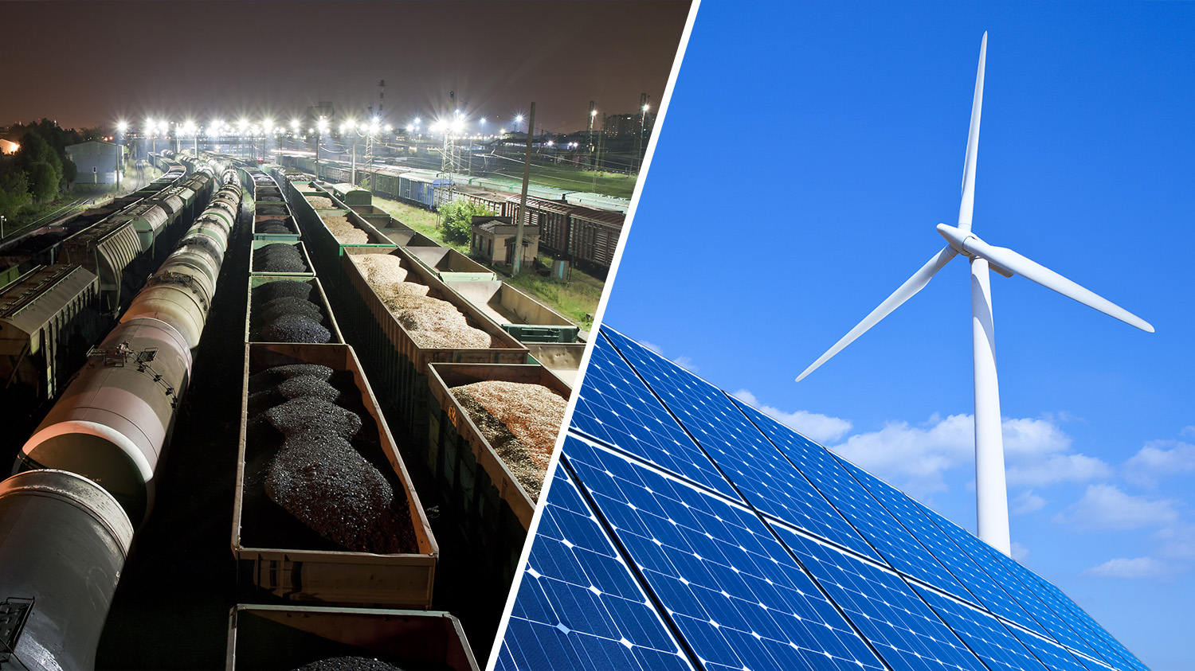
Stored Energy
Energy
Where is the
storage?

Slide 16
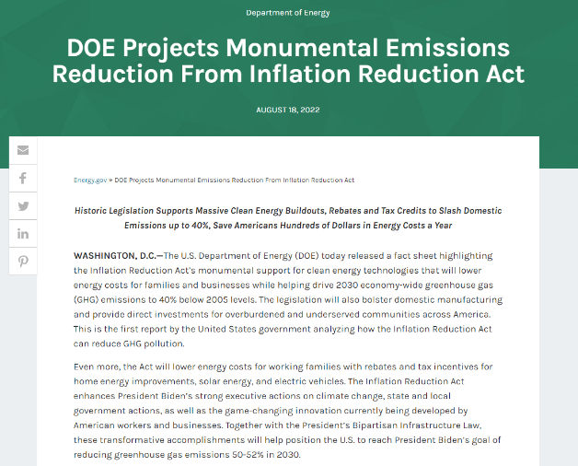
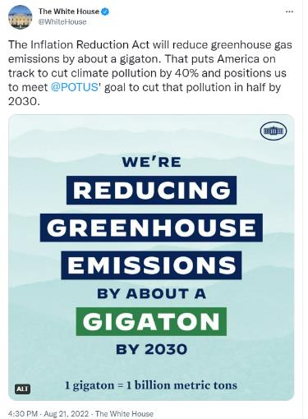
Inflation Reduction Act of 2022 (IRA) $369B Funding

Slide 17
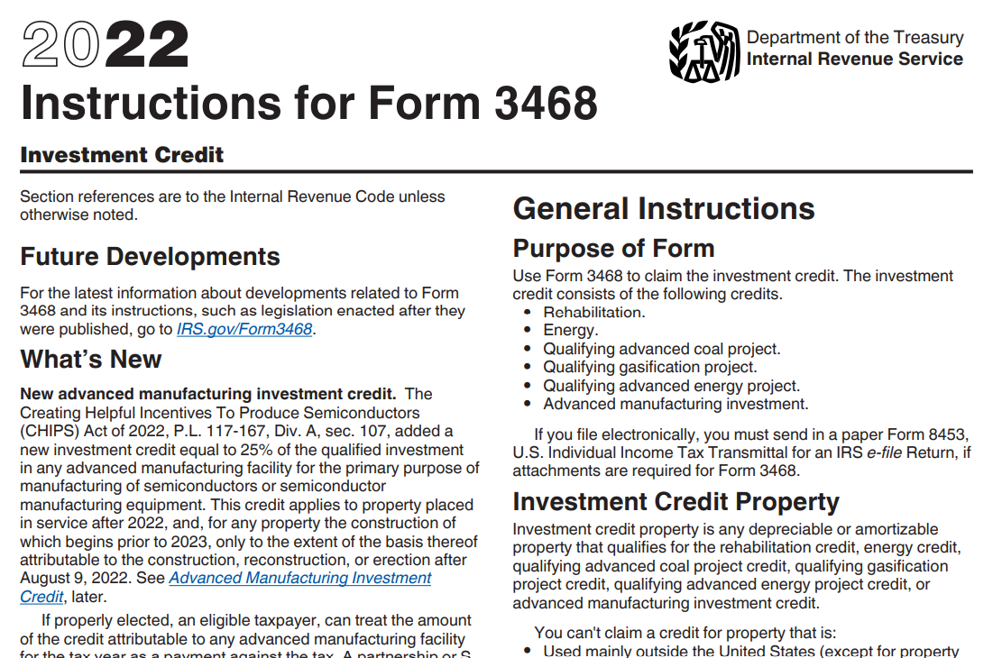
IRS Form 3468
IRS Form 3468

Slide 18
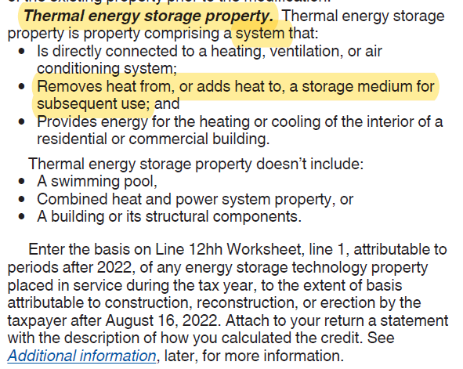
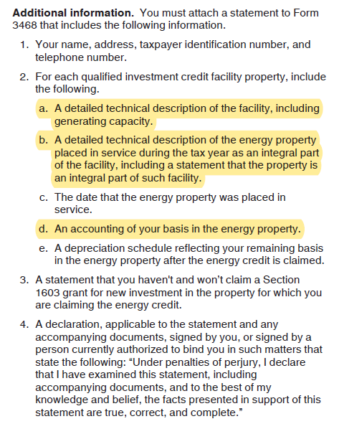
IRS Form 3468—Thermal Energy Storage

Slide 19
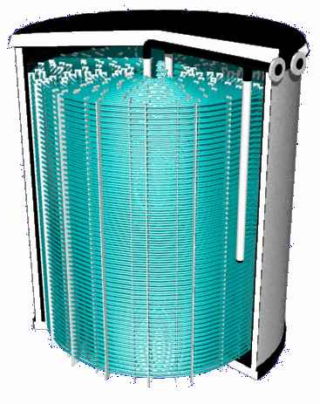
Thermal Storage Tank
Ice-on-Coil Internal Melt
Tank
Expansion Chamber
Insulation
Heat Exchanger
Notes:
The thermal storage device consists of a Polyethylene seamless tank. The heat exchanger is made of almost 3 miles of polyethylene tubing spaced evenly apart. The all-welded polyethylene heat exchanger takes up 10% of the volume of the tank. 80% of the volume is the water, and the final 10% is the expansion chamber, since when the water freeze it expands. This expansion just raise the water level in the tank. When fully charged the tank is solid block of ice, except for the 6” of expansion water on top. And, with an inventory meter reading the expansion water level, we can tell the amount of energy stored in the tank. The H2O in the tank never leaves the tank. It simply changes from its "low energy " ice phase, to its "high energy" water phase.

Slide 20
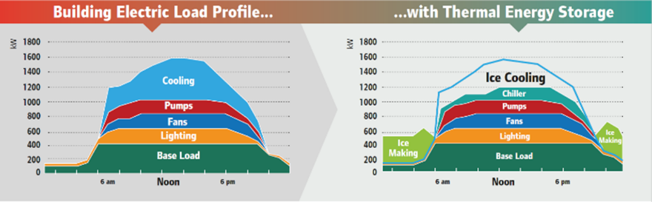
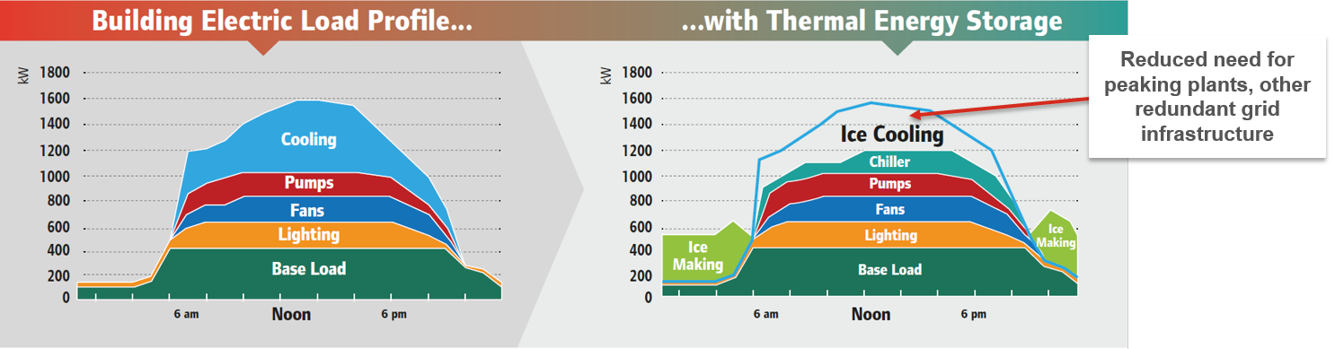
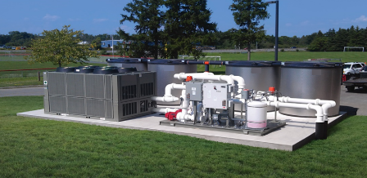
Shift Building Demand by
Cooling with Thermal Batteries
Air-conditioning can account for over 40% of the summer peak-day load
Thermal Batteries meet grid challenges
    Addressing critical utility/grid peaks
    Avoid expensive and high-emission peaker plants
    Supporting advanced grid services and demand response
Notes:
[SLIDE] If the chiller is connected to a hydronic heating loop, it can be placed into heating mode to satisfy the heating loads. Any coincident cooling that takes place may also be satisfied. However, as we learned during our previous program, unless excess heat is rejected, or deficit heating is inserted, the system will not likely balance in real time. If we need more heating than we have heat to reject, the energy stored in the tanks can serve as that source of heat. Remember: ice is water with enough energy removed. If still more energy is required in the building, we can operate the air-water heat pump too, and source more Btus from the outdoor air. We’ll revisit that mode in a moment. On the flip side, if we have more cooling than heating loads, cooling can be provided by the tanks or by the air-water heat pump operating in cooling mode.

Slide 21
Let’s Consider A Local Example
First – A Few Assumptions
  Office Building with operating hours of 6 AM to 8 PM
  Peak Load of 600 tons
Estimated Utility Rate – Ameren, LGS rate, secondary service
  Demand charge of $6.19/kW
  First 150 kWh/kW - $0.112/kWh
  Next 200 kWh/kW - $0.836/kWh
  >350 kWh/kW - $0.0563/kWh
Federal Tax Incentive
  Investment Tax Credit of 40% for TES system

Slide 22
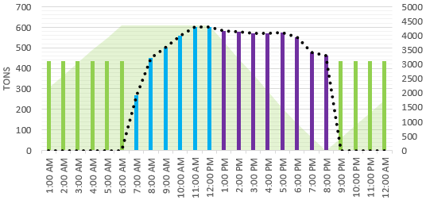
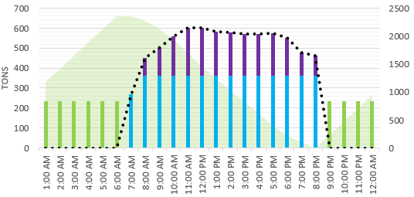
Estimated Chiller Plant Cost Summary with ITC
+ Full Storage for 4 hours
* Annual estimated electric utility costs for the chillers
Disclaimer: Consult your tax advisor for specific details on your project.

Slide 23

Heating in Cold Urban Cities
Replace gas boilers with electric
  Resistance heat will exacerbate winter peaking
GSHP restricted by underground infrastructure
ASHP limited by ambient
  Electric reheat supplemental
  Defrost derating
  Limited roof space

Slide 24
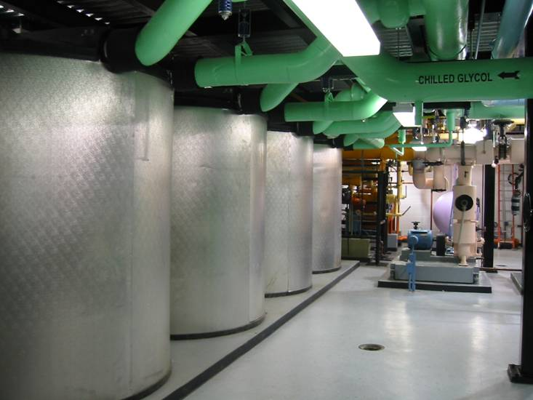
Thermal Energy Storage Tank Capacity
1 Tank is 8’-6” Tall x 7’6” Dia.
  1655 Gal of Water = 13,786 lbs.
  13,786 lbs. x 144 Btu’s/lb. ~2,000,000 Btu’s
  2,000,000 Btu’s =
  ~14 Gallons of Fuel Oil
  ~20 Therms of Natural Gas
  ~160 Ton-hrs.
A New York City project has 44 tanks
  88,000,000 Btu’s
  616 gal of Fuel Oil
  880 Therms
  88 Mlbs of Steam
  ~7,000 Ton-hrs.
There’s a lot of stored energy in the cold water contained in these tanks!
Notes:
The energy stored in one 1190 tank is approximately equivalent to 2 million Btus which is about 14 gallons of fuel oil or about 20 therms of natural gas,
So, the 44 tanks in an installed system in NYC, has about 88 million Btus, which is equivalent to about 600 gallons of fuel oil. That’s a lot of heat!

Slide 25
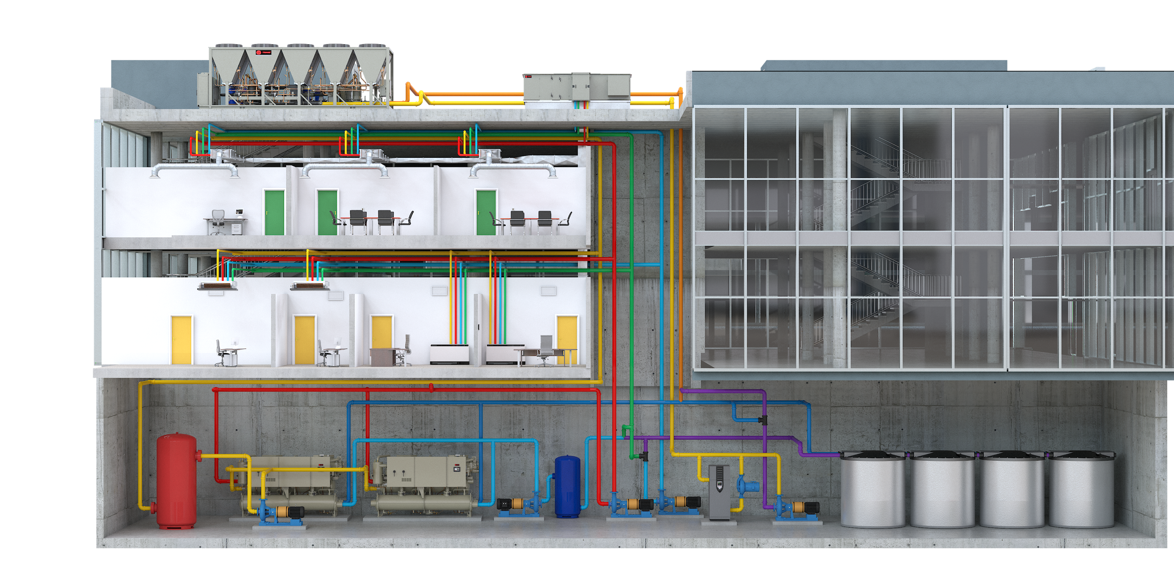

Storage-Source Heat Pump System (SSHP)
An innovative way to make all-electric heat pump heating possible even in cold climates and dense urban environments where there is limited roof space.
FEATURES
Energy efficient: Reclaims excess heat from the building using it to heat when needed.
Reliable operation: Collects and stores heat from air-to-water heat pump operation during favorable conditions enabling heating at all outdoor conditions including extreme cold.
Save roof space: Collecting and storing heat over 24-hour period for later use, can reduce required air-to-water heat pump capacity and cost.
Higher supply water temperatures: Sourcing energy from a stable thermal energy storage source enables up to 130F.
Lowers costs: Storing thermal energy for later use provides flexibility to use lower-cost electricity. Thermal energy storage can frequently qualify for up to 40% tax credit reducing overall system costs.
AWHPs
Chiller-Heaters
Trickle Heater
Thermal Energy Storage

Slide 26
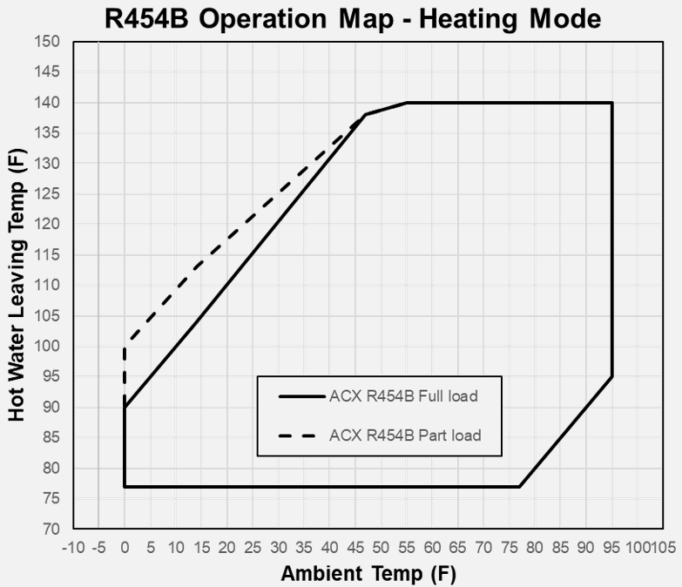
Extending the Low Ambient Capabilities
AWHPs have operational limits at low ambient temperature
  Capacity and hot water temperature drop dramatically
  Storage extends the map
Higher hot water temperatures
at
Lower ambient
Typical SSHP
-35 -30 -25 -20 -15
Notes:
AWHP hot water temperature and capacity drop substantially as ambient temperatures approach their operational limit, typically 0F.
[CLICK] Using Chiller-Heaters and Thermal Storage provide a substantially broader operating map.
Storage Source Heat Pump systems ARE a heating solution for cold climate zones and they use today’s proven technology.

Slide 27
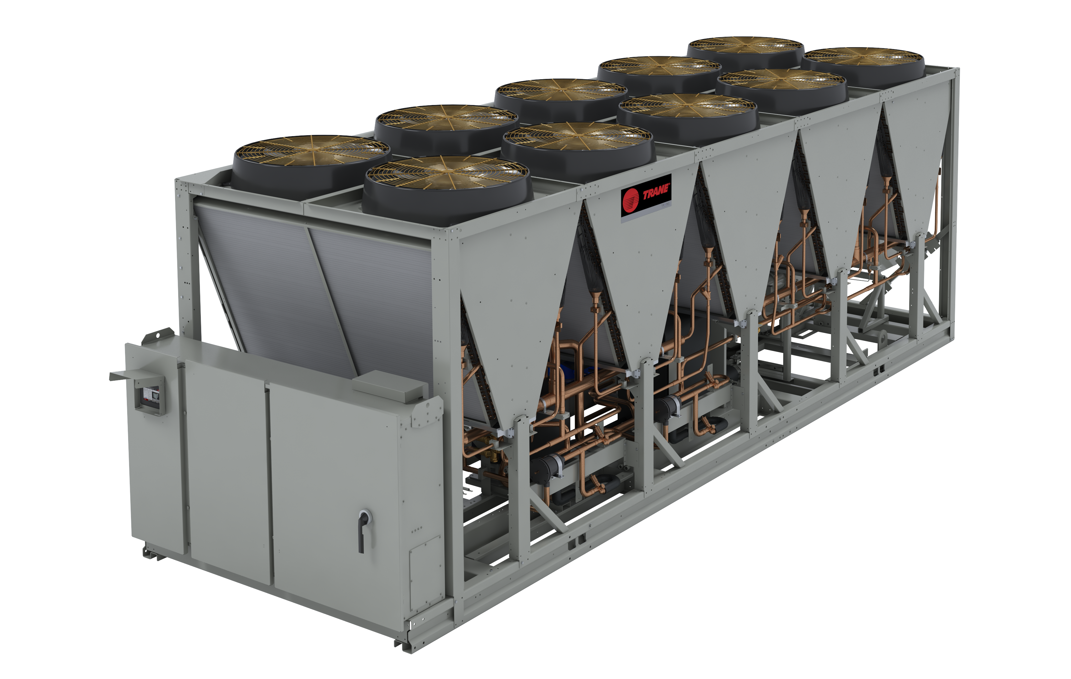
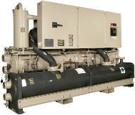

Collecting energy
AWHP
Source and Sink Loop
AWHP
Source and Sink Loop
Trickle heater
68° F
M
M
56° F
AWHP
M
Heat Source
Cooling Distribution Loop
Heat Sink
Heating Distribution Loop
M
Trickle
Heater
Cooling Distribution Loop
Heating Distribution Loop
Cooling
Distribution Loop
Heating
Distribution Loop
T4
M
M
M
M
SSHP Energy
Transfer Loop
Chiller-Heater
32° F
to
40° F
57° F
100°F
68° F
M
M
TES
Heating coils
42° F
SSHP Energy Storage Transfer Loop
Cooling coils
115°F
Climate zones 5 and colder
Notes:
Finally, a “Trickle Heater” may be installed for backup or redundancy purposes. [CLICK]
The trickle heater needs only to be sized, based on the 24-hour heating loads of the building, because we have storage, and it doesn’t need to meet the peak design day hourly heating load.

Slide 28
First SSHP Installation in LaCrosse, WI
Trane Training Center
FEATURES
80,000 SF Building.
180-Ton Air to Water Heat Pump
Two 110-Ton Heat Recovery Chillers
Seven Ice Storage Tanks-160 ton-hour
Research Project--optimize controls, address heat recovery options
Installed November 2023. Mild winter. Offering tours. Consortium of utilities monitoring performance.
Recruiting partners to demonstrate technology at other cold locations and accelerate decarbonization
AWHPs
Chiller-Heaters
Trickle Heater
Thermal Energy Storage

Slide 29
Thank You!
Questions?
Notes:
Midwest Region – 'Low Hanging Carbon'

